Slide 1
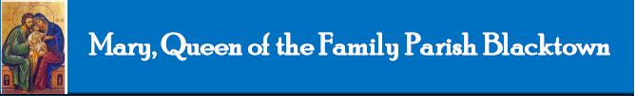
Mary, Queen of the Family Parish
is a welcoming, diverse, multicultural, Catholic community.
We seek to live, teach and share the joy of the Gospel;
to grow as disciples of Jesus through prayer, witness and action
and to respond to the needs of the family in the Blacktown community and beyond.
Notes:
Saturday 5.30PM First Sunday of Advent
16th Sunday in Ord Time Year B

Slide 2

Welcome to our Parish …
Fourth Sunday of Advent
You have entered a SACRED SPACE ... A SACRED TIME…
Please ensure all mobile phones are switched off.
Please be respectfully quiet as we prepare for our Celebration.
Notes:
Saturday 5.30PM First Sunday of Advent
16th Sunday in Ord Time Year B

Slide 3
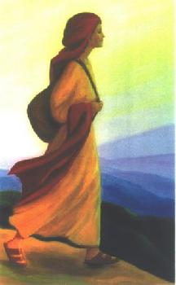
Mary set out at that time and went as quickly as she could to a town in the hill country of Judah.
Notes:
16th Sunday in Ord Time Year B

Slide 4
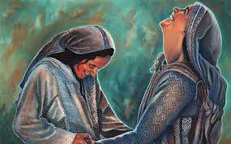
She went into Zechariah's house and greeted Elizabeth. Now as soon as Elizabeth heard Mary's greeting,
the child leapt in her womb …
Notes:
16th Sunday in Ord Time Year B

Slide 5
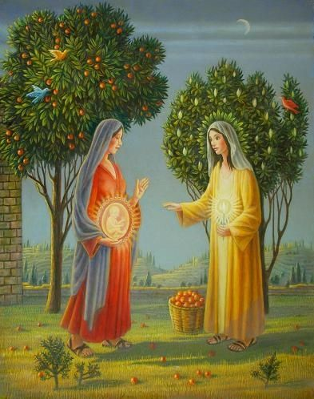
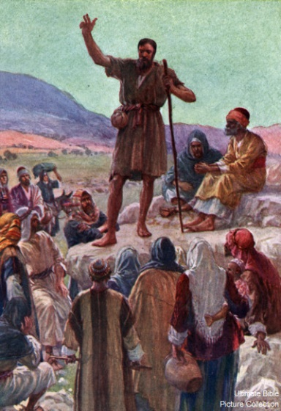
She gave a loud cry and said,
“Of all women you are the most blessed, and blessed is the fruit of your womb.”
Notes:
16th Sunday in Ord Time Year B

Slide 6
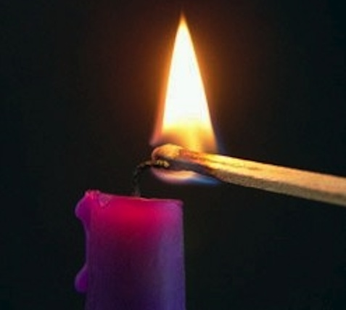
How will I acknowledge the presence of Jesus in in the coming days?

Slide 7
PLEASE STAND

Slide 9
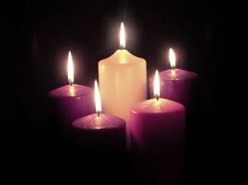
Lord our God, we praise you for your Son, Jesus Christ: he is Emmanuel, the hope of the peoples, he is the wisdom that teaches and guides us, he is the Saviour of every nation.
Lord God, let your blessing come upon us as we light the candle of love.
May we bring the love of Christ to all those we meet during the coming days. May he come quickly and not delay.

Slide 11

Responsorial Psalm
Lord, make us turn to you;
let us see your face
and we shall be saved.

Slide 12


Slide 13
Gospel Acclamation
Alleluia, alleluia!
I am the servant of the Lord:
may his will for me be done.
Alleluia!

Slide 15
APOSTLES’ CREED
I believe in God,
the Father almighty,
Creator of heaven and earth,
and in Jesus Christ, his only Son, our Lord,
(At the words that follow, up to and including the Virgin Mary, all bow.)
who was conceived by the Holy Spirit,
born of the Virgin Mary,
suffered under Pontius Pilate,
was crucified, died and was buried;
he descended into hell;

Slide 16
on the third day he rose again from the dead;
he ascended into heaven,
and is seated at the right hand
of God the Father almighty;
from there he will come to judge
the living and the dead.
I believe in the Holy Spirit,
the holy catholic Church,
the communion of saints,
the forgiveness of sins,
the resurrection of the body,
and life everlasting. Amen.

Slide 18
First Collection
This collection goes to the Bishop
for the support of the Diocese.
Thank you for your contribution

Slide 20
Holy, Holy, Holy
Holy, Holy, Holy Lord God of hosts,
Heaven and earth are full of your glory.
Hosanna in the highest
Blessed is he who comes
in the name of Lord,
Hosanna in the highest.
The English translation of The Roman Missal © 2010,
International Commission on English in the Liturgy Corporation. All rights reserved.

Slide 22
Save us, Saviour of the world,
for by your Cross
and Resurrection
you have set us free.
Memorial Acclamation
When we eat this Bread and drink this Cup, we proclaim your Death,
O Lord, until you come again.
We proclaim your Death, O Lord,
and profess your Resurrection
until you come again.
The English translation of The Roman Missal © 2010,
International Commission on English in the Liturgy Corporation. All rights reserved.
Notes:
Sunday 10AM First Sunday of Advent
7am - 14th Sunday in Ord Time
16th Sunday in Ord Time Year B

Slide 24
Amen
When we eat this Bread and drink this Cup, we proclaim your Death,
O Lord, until you come again.
Amen
We proclaim your Death, O Lord,
and profess your Resurrection
until you come again.
The English translation of The Roman Missal © 2010,
International Commission on English in the Liturgy Corporation. All rights reserved.
Notes:
Sunday 10AM First Sunday of Advent
7am - 14th Sunday in Ord Time
16th Sunday in Ord Time Year B

Slide 26
Lamb of God
Lamb of God, you take away the sins of the world, have mercy on us.
Lamb of God, you take away the sins of the world, have mercy on us.
Lamb of God, you take away the sins of the world, grant us peace.
The English translation of The Roman Missal © 2010,
International Commission on English in the Liturgy Corporation. All rights reserved.

Slide 28
Second Collection
What you contribute now
is for the support of our
parish and its mission.
Thank you for your generosity

Slide 29
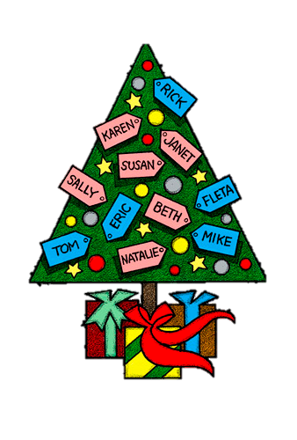
VINNIES GIVING TREE AND APPEAL
Many thanks for your support of Vinnies many projects throughout the year.
The appeal last weekend
raised $6513.30 which
will be used to support the
needy in Blacktown.

Slide 30
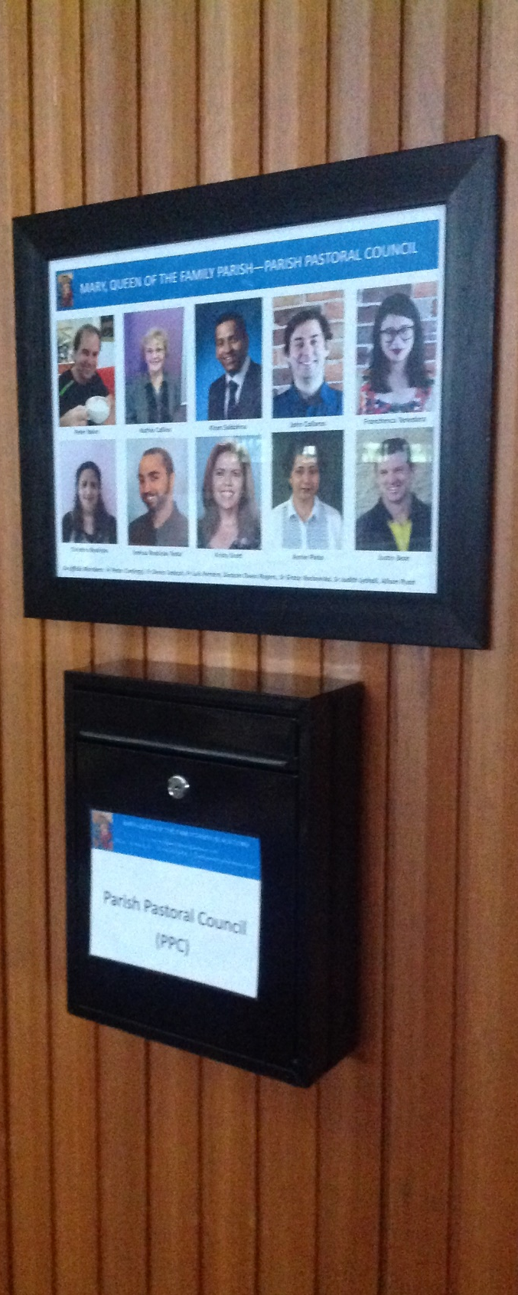
PPC MINISTRY SURVEY
If you are in a Ministry and are willing to complete a survey please leave your name and number at the Parish Office,
or place your details in the PPC Letterbox in either Church.
Notes:
16th Sunday in Ord Time Year B

Slide 31
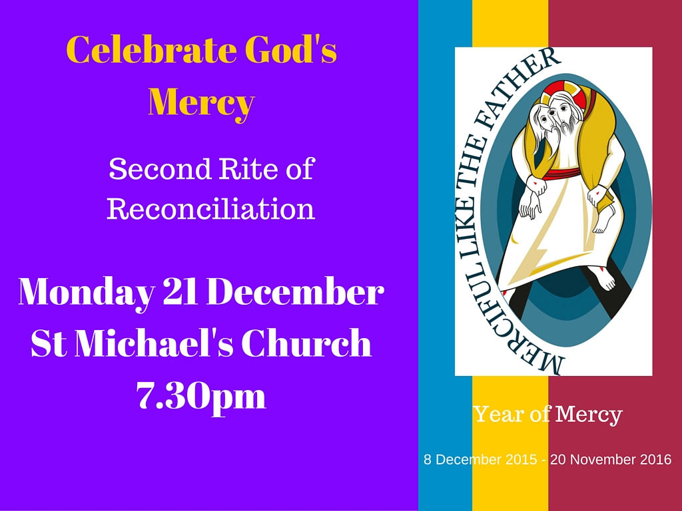

Slide 32
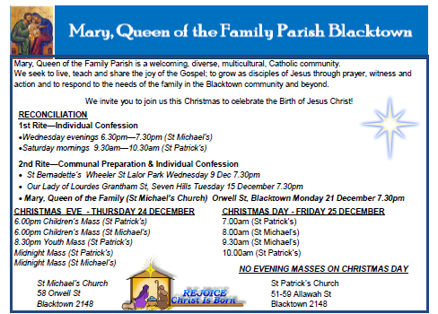
Please take home your Parish Bulletin!

Slide 34
How will I acknowledge the presence of Jesus in in the coming days?

Slide 38
Penitential Act
Lord have mercy. Lord have mercy.
Christ have mercy. Christ have mercy.
Lord have mercy. Lord have mercy.
The English translation of The Roman Missal © 2010,
International Commission on English in the Liturgy Corporation. All rights reserved.

Slide 40
GLORIA
Glory to God in the highest,
and on earth peace to people of good will.
We praise you, we bless you,
we adore you, we glorify you,
we give you thanks for your great glory,
Lord God, heavenly King,
O God, almighty Father.

Slide 41
Lord Jesus Christ, Only Begotten Son,
Lord God, Lamb of God, Son of the Father,
you take away the sins of the world,
have mercy on us;
you take away the sins of the world,
receive our prayer;
you are seated at the right hand of the Father, have mercy on us.

Slide 42
For you alone are the Holy One,
you alone are the Lord,
you alone are the Most High, Jesus Christ, with the Holy Spirit,
in the glory of God the Father.
Amen.
The English translation of The Roman Missal © 2010,
International Commission on English in the Liturgy Corporation. All rights reserved.

Slide 43



www.mqofblacktown.org.au
    www.facebook.com/blacktowncatholics
@mqofblacktown

